Slide 1
Air Masses and Fronts

Slide 2
Air Masses:
Air moves from areas of high pressure to low pressure, which are caused by the uneven heating of the Earth

Slide 3
Air Mass:
A large body of air throughout which temperature and moisture content are similar; take on the characteristics of the area over which they sit and remain stationary

Slide 4
Types of Air Masses:
Classified by their temperature and moisture content which are dependent upon the are over which they formed

Slide 5
Types of Air Masses:
Continental – dry air mass that formed over land (c)
Maritime – wet air mass that formed over water (m)
Tropical – warm air mass that formed over warm areas (T)
Polar – cold air mass that formed over cold areas (P)

Slide 6
Types of Air Masses:
Air Mass | Symbol | Formed Over | Weather
Continental Tropical | cT | Warm land | Warm and dry
Continental Polar | cP | Cold land | Cold and dry
Maritime Tropical | mT | Warm water | Warm and wet
Maritime Polar | mP | Cold water | Cold and wet

Slide 7
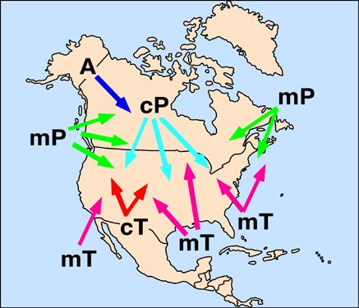
Types of Air Masses

Slide 8
Fronts:
Boundaries between air masses; cold air does not mix with less dense warm air; do not exist in tropics because no real temperature differences

Slide 9
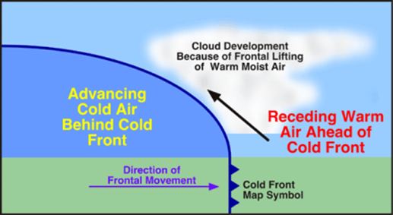
Cold Front:
The front edge of a moving mass of cold air that pushes beneath a warm air mass like a wedge; result in precipitation if warm air is humid; severe storms if moving fast

Slide 10
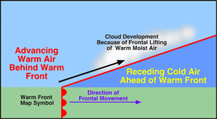
Warm Front:
The front edge of advancing warm air mass that replaces cold air with warmer air; generally results in precipitation over a large area

Slide 11
Stationary Front:
A front of air masses that move either very slowly or not at all; weather similar to a warm front

Slide 12
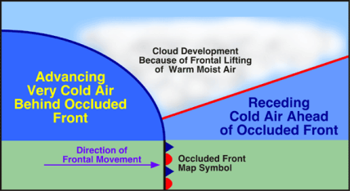
Occluded Front:
A front that forms when a cold air mass overtakes a warm air mass and lifts the warm air mass off the ground and over another air mass

Slide 13
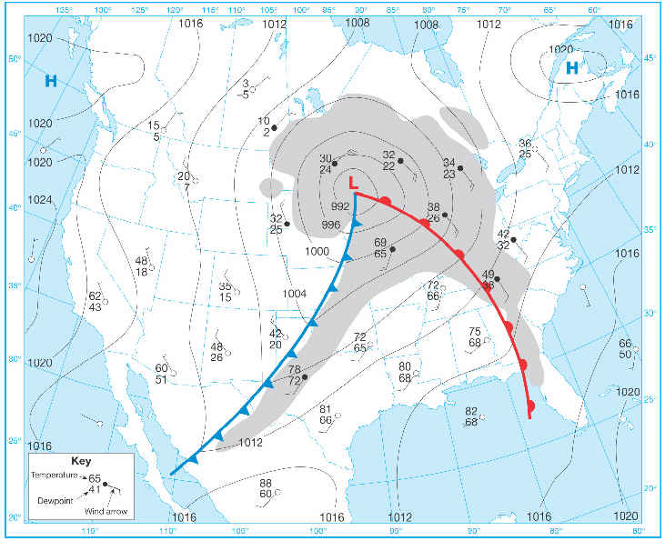
Cyclone:
A low pressure storm system that is characterized by rotating wind that moves towards the rising air of the central low pressure region.
Usually lasts several days
Spins counterclockwise
Follows storm tracks or routes

Slide 14
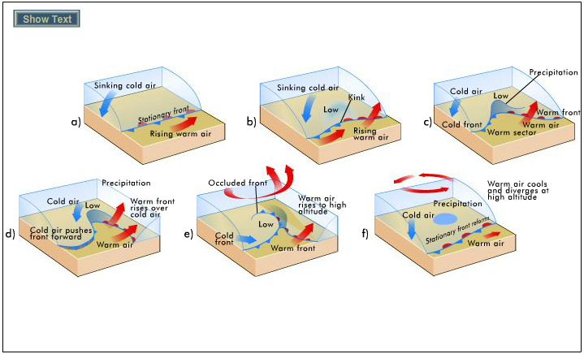

Slide 15
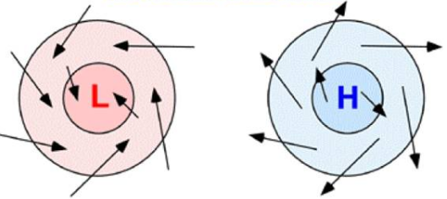
Anticyclones:
Flows outward from a center of high pressure in a clockwise motion; brings dry weather because of sinking air in middle does not promote cloud formation

Slide 16
