Slide 1
Matter Notes

Slide 2
Matter:
Anything that takes up space (volume) and has mass

Slide 3
Mass:
The measure of the amount of matter in an object

Slide 4
Properties of Matter:
Physical Properties: characteristics that can be observed without changing the compositions of the substance
EX: density, color, hardness, freezing point, boiling point, and the ability to conduct an electrical current
Chemical Properties: characteristics that describe how a substance reacts with other substances to produces different substances
EX: ability to form rust, ability to form/not form certain compounds

Slide 5
Density:
The measure of the amount of mass per unit volume

Slide 6
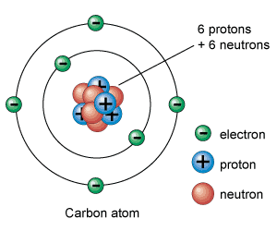
Atom:
The smallest unit of an element that maintains the chemical properties of that element; cannot be broken down into smaller units that still have the same chemical and physical properties of that atom

Slide 7
Atomic Structure:
Nucleus: dense region of matter and mass found in center of atom
Protons: positively charged subatomic particles found in the nucleus, the number of protons determines the atomic number and the identity of the element

Slide 8
Atomic Structure:
Neutrons: A subatomic particle with no charge and is located in the nucleus of the atom
Electrons: Subatomic particle with a negative charge found in a certain region of space around the nucleus called the electron cloud; kept close to the atom due to the attraction between the opposite charges of the electron and proton

Slide 9
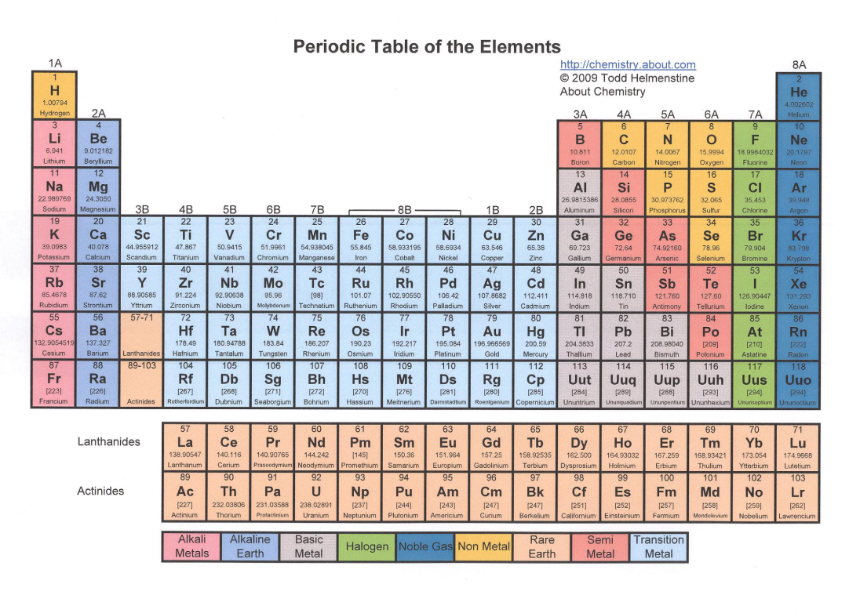
Element:
A substance consisting of only one type of atom, cannot be broken down or separated into simpler substances by chemical means; all elements have the same atomic number

Slide 10
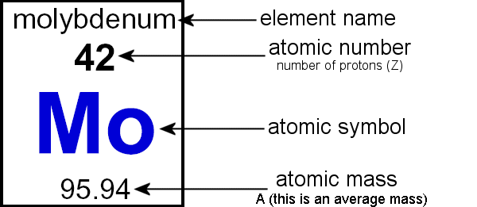
Atomic Number:
The number of protons in a nucleus; all atoms of any given element have the same atomic number; because an uncharged atom has the same number of protons and electrons, typically the number of electrons is the same as the atomic number

Slide 11
Atomic Mass:
The sum of the number of protons and neutrons in an atom; expressed in atomic mass units (amu) where a proton and neutron both have a mass of 1 amu; electrons (1/1840 amu) are ignored; averaged among isotopes

Slide 12
Periodic Table:
A chart that classifies the elements into columns, where elements in the same columns have similar electron arrangements thus they have similar chemical properties

Slide 13
Isotopes:
An atom that has the same number of protons (or the same atomic number) as the other atoms of the same element, but have a different number of neutrons (and thus a different atomic mass)

Slide 14
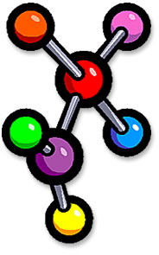
Compound:
A substance made up of atoms of two or more different elements joined together by chemical bonds

Slide 15
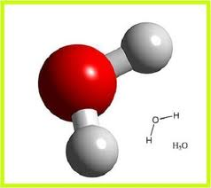
Molecule:
A group of atoms held together by chemical forces; the smallest unit of matter that can exist by itself and retain all of a substance’s chemical properties

Slide 16
Combination of Atoms:
Atoms → Elements → Molecules → Compounds
A chemical formula is a combination of letters and numbers which show what elements make up a compound:
Glucose = C₆H₁₂O_{6,} Six carbons, twelve hydrogen, six oxygen atoms
A chemical equation is a series of letter and numbers which show you the reactants and products of a chemical reaction:
CH₄ + 2O₂ → CO₂ + 2H₂O, one methane molecule and two oxygen molecules yields one carbon dioxide and two water molecules

Slide 17
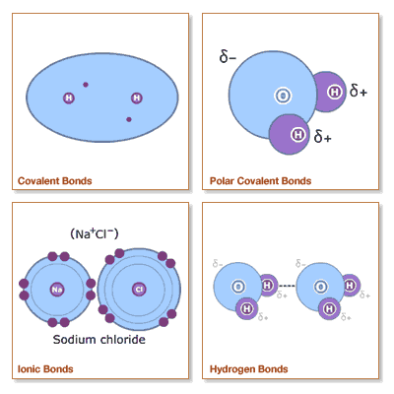
Chemical Bonds
Forces that hold atoms together; done by sharing and transferring electrons

Slide 18
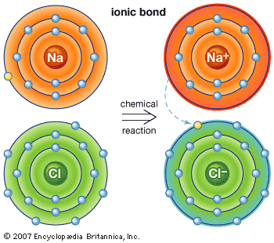
Ionic Bond:
Once two atoms exchange an electron, one is positively charged (lost the electron) and the other is negatively charged (gained the electron), the opposite charges attract forming an ionic bond
Ion: An atom or molecule that has gained or lost one or more electrons and has a negative or positive charge

Slide 19
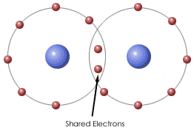
Covalent Bond:
A bond formed when atoms share one or more pairs of electrons

Slide 20
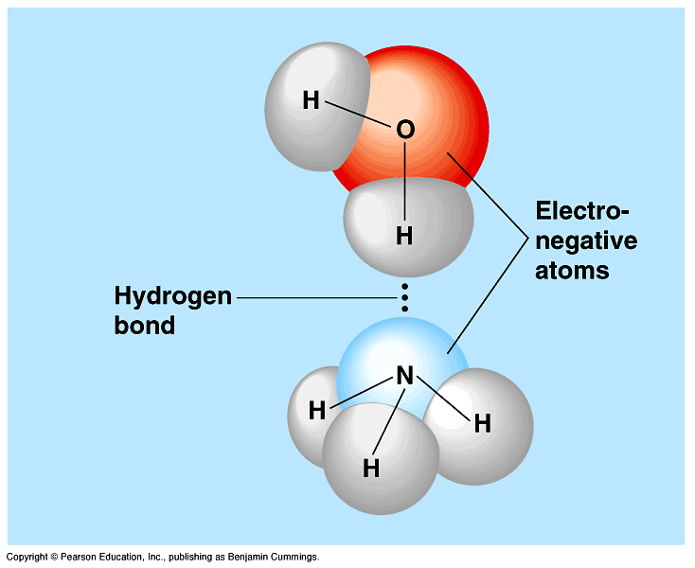
Polar Bond:
Unequal sharing of electrons leads a molecule to have a slightly positive end and a slightly negative end

