Slide 1
Our Solar System

Slide 2
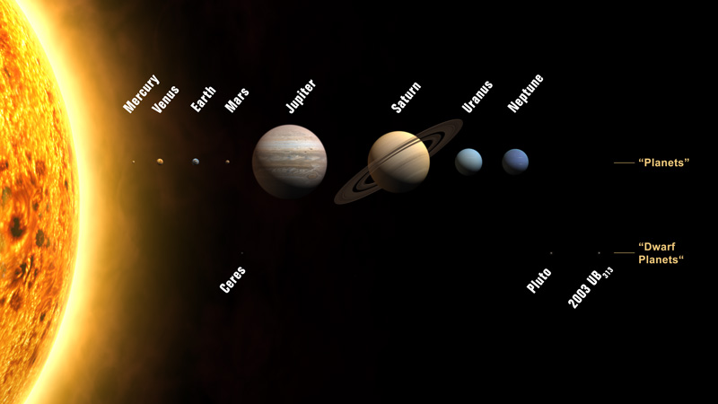

Slide 3
Solar System:
The sun and all of the planets and other bodies that travel around it

Slide 4
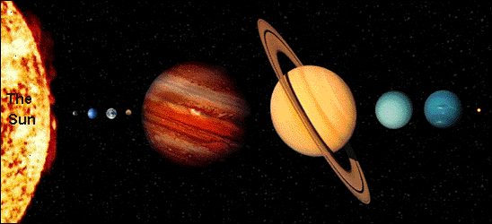
Planet
A celestial body that orbits the sun, is round because of its own gravity, and has cleared the neighborhood around its orbital path

Slide 5
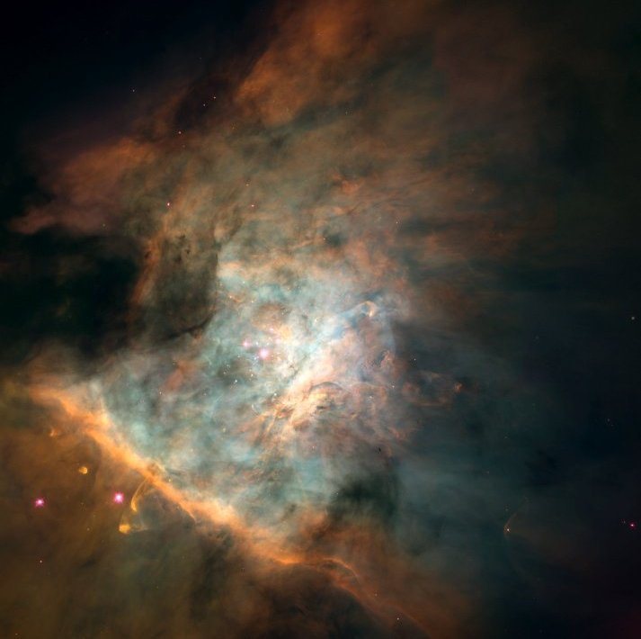
Solar Nebula:
A rotating cloud of gas and dust from which the sun and planets formed

Slide 6
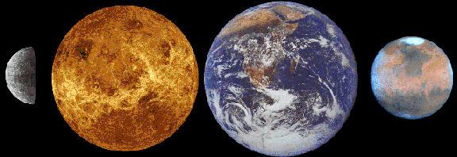
Inner Planets
Formed from much heavier elements such as iron and nickel, with the densest layers settling in the center. Smaller, rockier, and denser than the outer planets
Includes: Mercury, Venus, Earth, and Mars

Slide 7
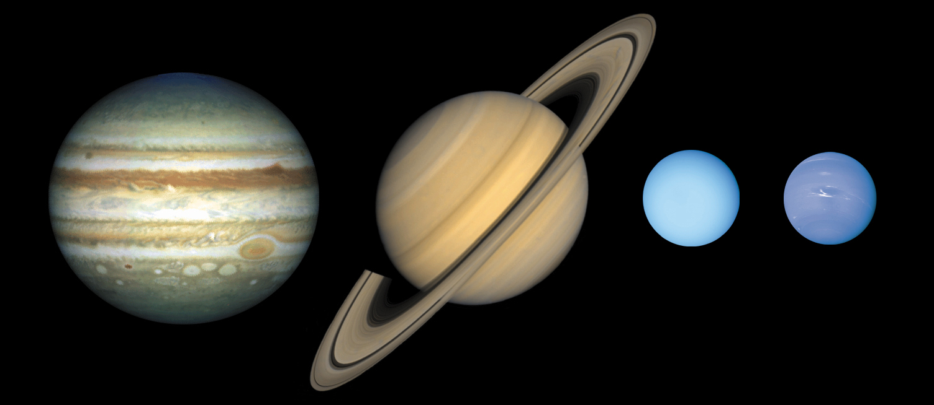
Outer Planets
Formed in a much colder area, thus they did not lose their gases (helium and hydrogen). Larger gaseous planets.
Includes: Jupiter, Saturn, Uranus, and Neptune

Slide 8
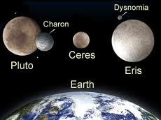
Dwarf Planets
Ice balls made of frozen gases and rock
Includes: Pluto

